Slide 1

DSM2
Delta Applications
DSM2 Training
September 2009
Jamie Anderson, PhD, PE
Delta Modeling Section
California Department of Water Resources
Notes:
DSM2 Users Group: "EXAMPLE: Filling in Martinez Stage"
2004.04.27

Slide 2
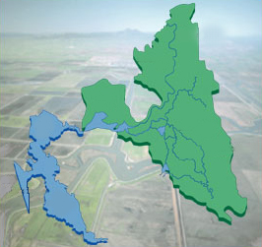
Bay-Delta System
DSM2 Domain
Sacramento
Sacramento
River
Redding
Stockton
San
Joaquin
River
San
Francisco
San
Francisco
Los Angeles
San Diego
Bay-Delta detail image from CALFED

Slide 3
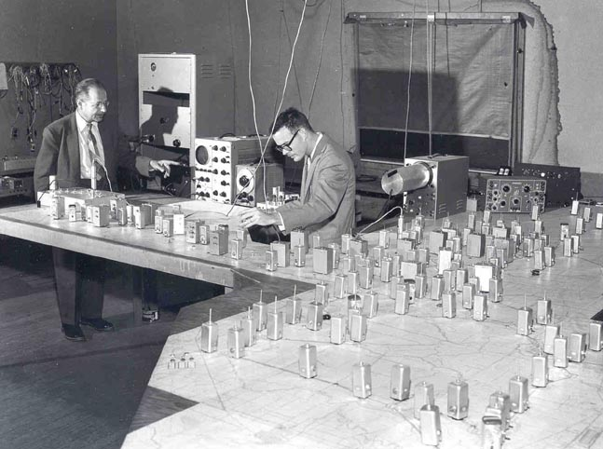

Slide 4
Delta Simulation Model 2
HYDRO
Hydrodynamics
QUAL
Water Quality
PTM
Particle Tracking
STM
Sediment Transport
Under development

Slide 5
DSM2 Applications
DSM2
Modes of Application
Historical
Replicate historical conditions
Forecasting
(Real-Time)
Project conditions for the near future
Planning
Hypothetical Delta changes

Slide 6
Delta Simulation Model 2 Domain
HYDRO-flow and velocity
QUAL-water quality
PTM-particle tracking
DSM2 Domain
Sacramento
Sacramento
River
Redding
Stockton
San
Joaquin
River
San
Francisco
San
Francisco
Los Angeles
San Diego
Bay-Delta detail image from CALFED

Slide 7



Model Dimensionality
a) 1-D representation
b) 2-D depth-averaged representation
Characteristics
Averaged
Characteristics
Averaged
c) 2-D laterally-averaged representation
d) 3-D representation
Characteristics
Averaged

Slide 8
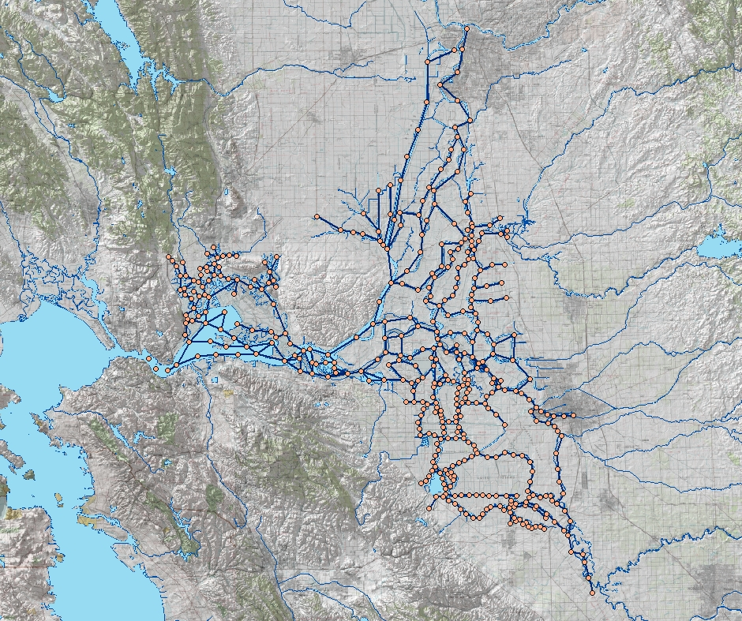
DSM2 Boundary Conditions
Sacramento River
Sacramento
Inflow & water quality
Export flow
Tributaries
Delta Island Consumptive Use
Martinez
Tidal Stage & Water Quality
Stockton
Exports
San Joaquin River
Image from USBR GIS Group

Slide 9
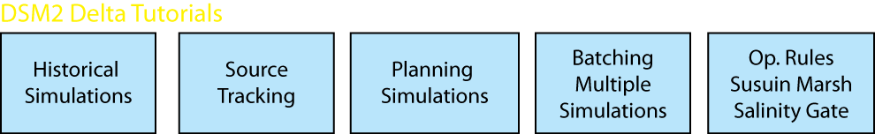
Delta Tutorials

